Slide 1

DEPARTMENT OF COMPUTER SCIENCE AND ENGINEERING
Professional Training - 1
DEEPFAKE DETECTION USING MACHINE LEARNING
PROJECT STUDENT GUIDE
DUBAGUNTLA VENU LAKSHMI SAI Dr. G. NAGARAJAN B.E.,M.E.,Ph.D.,
42110321 Professor, CSE

Slide 2
AGENDA
Certificate
Introduction
Abstract
Objective
System Architecture / Ideation Map
Module Implementation
Results and Discussions
Conclusion
References

Slide 3
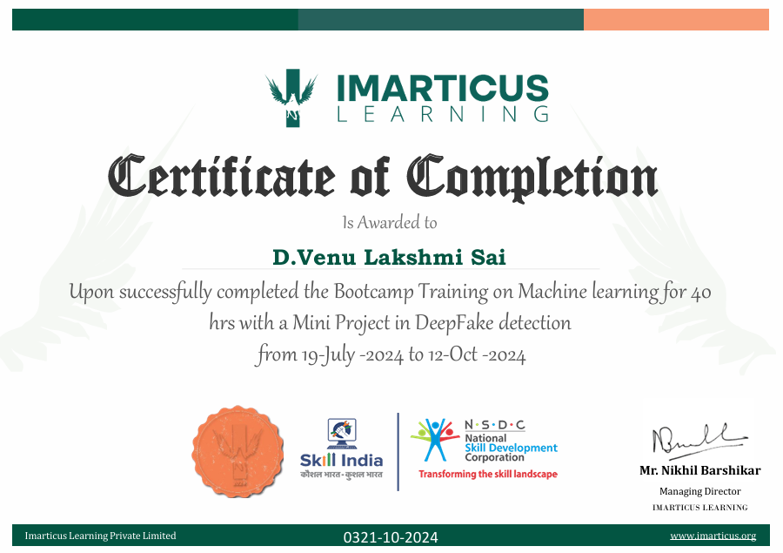
COURSE CERTIFICATE
23 October 2024

Slide 4
INTRODUCTION
The latest concern, deepfakes, is a term that is used to describe realistic, artificially generated media. It has been a growing concern due to the potential of its misuse in various areas such as social media, politics, and law enforcement. These deepfakes have been created with the help of high-level machine learning algorithms, so-called neural networks that can operate with the aid of facial expressions, lip movements, and even the actual voices of the people in the films in order to change them convincingly into existing videos or images.
TensorFlow is one of the most popular open-source machine learning frameworks that was developed by Google. With TensorFlow's flexibility and scalability, developers can create and train almost any machine learning model, including deepfake detection models.
TensorFlow is a project that is being worked on which is focused on creating a machine learning model with the capability of detecting and accurately analyzing deepfake images. With the help of deep learning, our ultimate goal is to design a system that will be able to tell the difference between the genuine and manipulated images, thus, regulate the risks generated by the deepfake technology.
23 October 2024
School of Computing - CSE

Slide 5
ABSTRACT
Over the last few decades, rapid progress in AI, machine learning, and deep learning has resulted in new techniques and various tools for manipulating multimedia. Though the technology has been mostly used in legitimate applications such as for entertainment and education, etc., malicious users have also exploited them for unlawful or nefarious purposes. For example, high-quality and realistic fake videos, images, or audios have been created to spread misinformation and propaganda, foment political discord and hate, or even harass and blackmail people. The manipulated, high-quality and realistic videos have become known recently as Deepfake. Various approaches have since been described in the literature to deal with the problems raised by Deepfake. To provide an updated overview of the research works in Deepfake detection summarizing 112 relevant articles from 2018 to 2020 that presented a variety of methodologies. We analyze them by grouping them into four different categories: deep learning-based techniques, classical machine learning-based methods, statistical techniques, and blockchain-based techniques. We also evaluate the performance of the detection capability of the various methods with respect to different datasets and conclude that the deep learning-based methods outperform other methods in Deepfake detection.

Slide 6
OBJECTIVE
Building a deep learning model : With the rise of fake news and the vast amount of multimedia content on the Internet, modern deepfake technologies have become very real. By doing so, we design a deep learning model, which will be robust enough to detect deep-fake images from the real ones. Although not new
Training the model : Train the model on a different datasets of real and deepfake images to enhance its generalization ability and accuracy.
Evaluating performance : Evaluate the model's performance using appropriate metrics, such as accuracy, precision, recall, and F1-score.
Addressing challenges : Explore and address potential challenges, such as the creation of high-quality deepfakes and the need for large and different datasets

Slide 7
LITERATURE SURVEY
Author(s) | Year | Title | Key Findings
MesoNet | 2018 | Convolutional Neural Networks (CNNs) with TensorFlow (Afchar et al) | specifically focusing on small, local visual artifacts left by deepfake generation processes.
Keras | 2018 | Generative Adversarial Networks (GANs) and TensorFlow(Wang et al) | identify specific noise patterns and image artifacts.
Rossler | 2019 | FaceForensics++ Dataset | to build state-of-the-art models for detecting manipulated faces.
Mirsky and Lee | 2020 | Generative Adversarial Networks (GANs) | for detecting deepfakes in TensorFlow.
mirsky | 2021 | Face Forensics terson flow | dynamic computational graph and efficient model training mech.

Slide 8
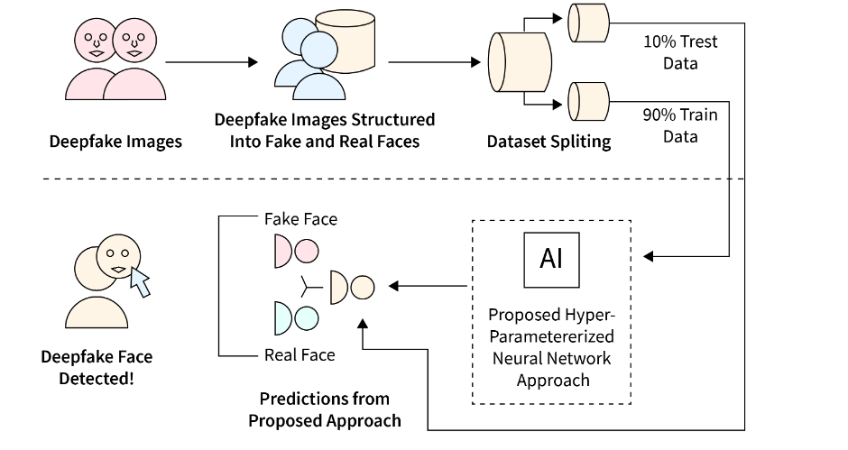
SYSTEM ARCHITECTURE / IDEATION MAP
Working system of developed model

Slide 9
MODULE IMPLEMENTATION
To implement deepfake detection using machine learning with TensorFlow, you can follow these steps:
Step 1: Understand the Problem
Deepfake detection involves identifying manipulated videos or images that have been generated using deep learning techniques. These manipulations can be subtle and challenging to detect with the naked eye, making machine learning a crucial tool in this process.
Step 2: Choose a Model Architecture
Several deep learning models can be used for deepfake detection. Convolutional Neural Networks (CNNs) are commonly used due to their effectiveness in image and video analysis. You can also consider more advanced models like EfficientNet or Vision Transformers, which have shown good results in video deepfake detection.
Step 3: Prepare the Dataset
You will need a dataset of real and deepfake videos or images. Popular datasets include FaceForensics++, Celeb-DF, and the DeepFake Detection Challenge (DFDC) Dataset. These datasets provide a variety of deepfake types and are suitable for training and testing your model.

Slide 10
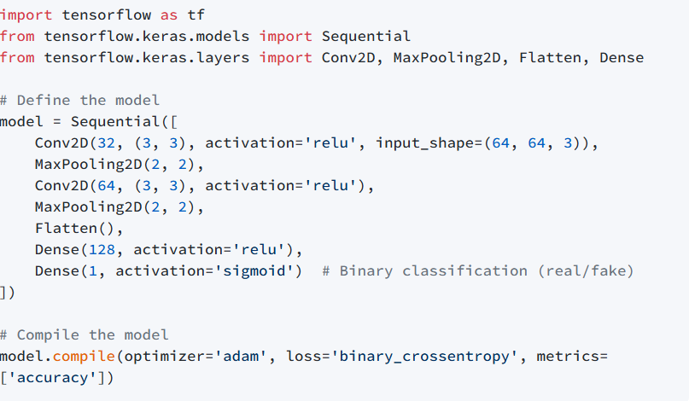
Step 4: Data Preprocessing
Preprocess your dataset to ensure consistency and compatibility with your model. This might involve resizing images, normalizing pixel values, and augmenting the data to improve model generalization.
Step 5: Implement the Model in TensorFlow
You can use TensorFlow or TensorFlow with Keras to implement your model. Here’s a basic example of how to define a CNN model in TensorFlow:

Slide 11
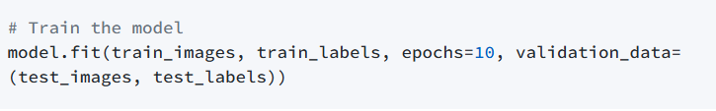

Step 6: Train the Model
Train your model using the prepared dataset. You can use techniques like data augmentation to increase the size of your dataset and improve model performance.
Step 7: Evaluate the Model
Evaluate the model’s performance on a separate test set to ensure it generalizes well to unseen data.
Step 8: Deploy the Model
Once your model is trained and evaluated, you can deploy it for real-world applications. This might involve integrating it into a web application or a mobile app where it can be used to detect deepfakes in real-time.

Slide 12
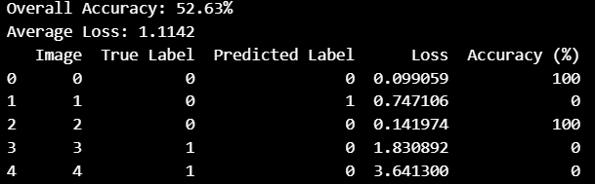
RESULTS AND DISCUSSIONS
For deepfake detection in images using machine learning with TensorFlow, the results will depend on several factors such as the model architecture, dataset quality, and training methodology.
From the given sample of datasets of real and fake images ,our model gives an overall accuracy 52.63% and average loss of 1.1142%.

Slide 13
CONCLUSION
In conclusion, deepfake detection is a critical area of research that aims to identify manipulated images and videos generated using advanced artificial intelligence techniques.
While there are many challenges and open issues in deepfake detection, such as the lack of standardized datasets, evolving technology, and adversarial attacks, researchers are continually developing new models and techniques to improve detection accuracy.
Python provides powerful libraries and frameworks that can be used to build and train deepfake detection models, making it easier for researchers and developers to create effective solutions to this growing problem.
As deepfakes continue to become more prevalent, it is crucial to continue to advance deepfake detection techniques to protect against their potential misuse.
In summary, machine learning with TensorFlow is a useful tool for detecting deepfakes, but we need to keep improving our methods as deepfakes get more advanced.

Slide 14
REFERENCES
Andreas Rossler, Davide Cozzolino, LuisaVerdoliva, ChristianRiess, Justus Thies, Matthias Nießner, "FaceForensics++:Learning to Detect Manipulated Facial Images"2019 IEEE/CVF International Conference on Computer Vision (ICCV).
Md Shohel Rana, Mohammad Nur Nobi,Beddhu Murali,Andrew H. Sung , Deepfake Detection: A Systematic Literature Review IEEE Access 10:1-1.
TensorFlow, December 2020, [online] Available: https://www.tensorflow.org/.
Brian Dolhansky, Russ Howes, Ben Pflaum, Nicole Baram and Cristian. Ferrer, The Deepfake Detection Challenge(DFDC)Preview Dataset, 2019.
Faceswap: Deepfakes software for all, February 2021, [online] Available: https://github.com/deepfakes/faceswap.
Gaojian Wang, Qian Jiang, Xin Jin, Xiaohui Cui, “FFR FD: Effective and Fast Detection of DeepFakes Based on Feature Point Defects”, 2020.
School of Computing - CSE

Slide 15
THANK YOU
We thank God, Our Department, Guide, Panel Members, Supportive Professors and all Technical and non Technical staff who helped us in our Project.

